Slide 1
KS Tree of Radix-2 Sparse-2 64-bit Adder

Slide 2
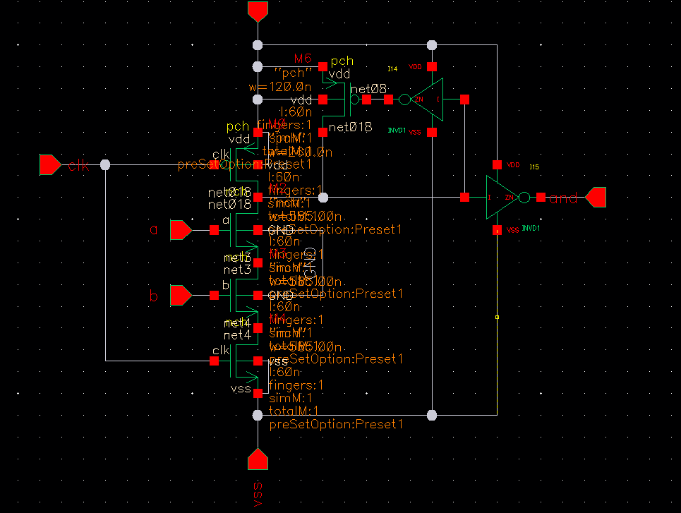
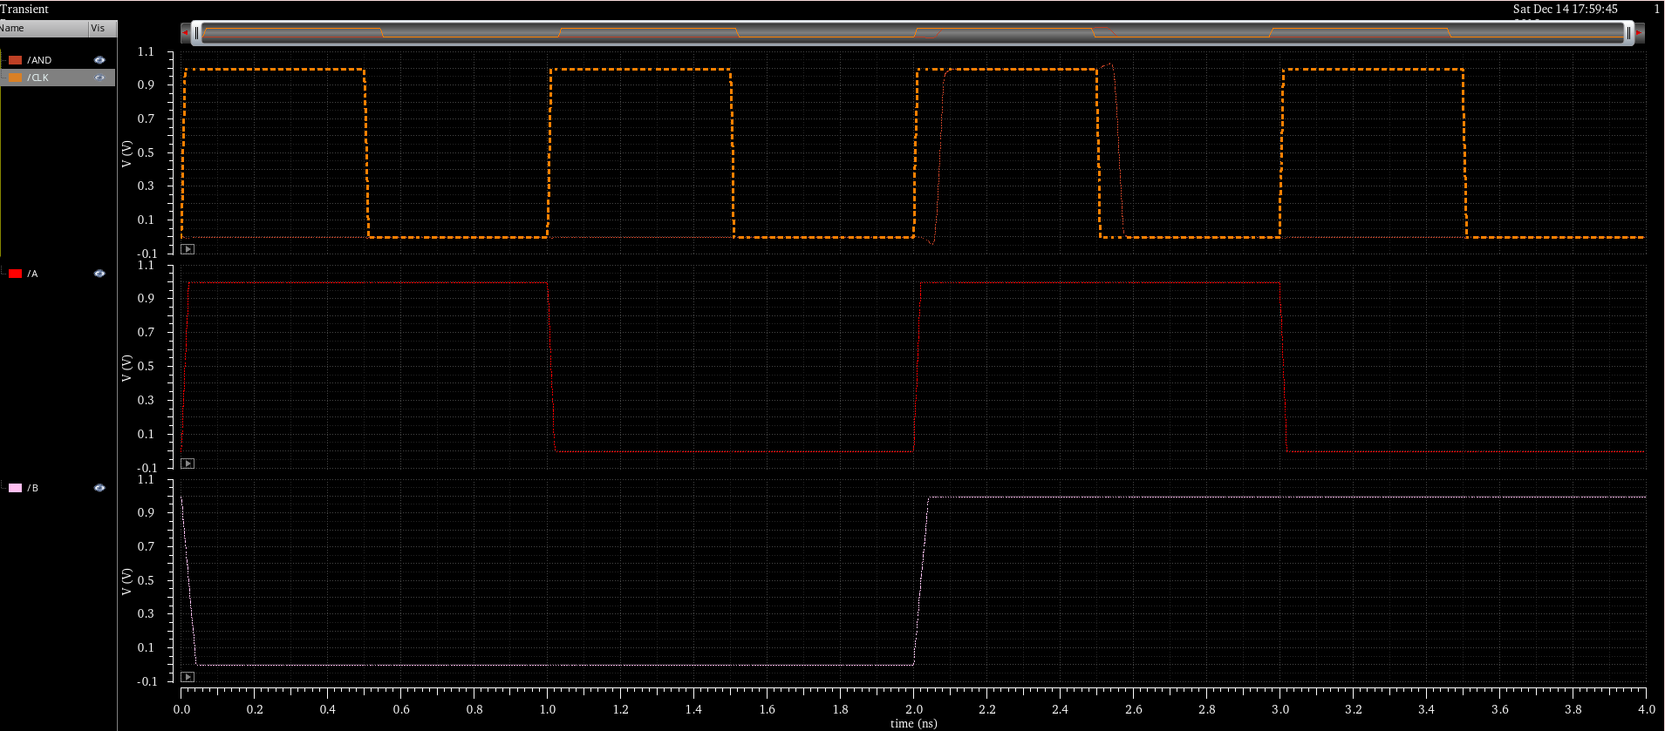
Basic block
Domino AND gate

Slide 3
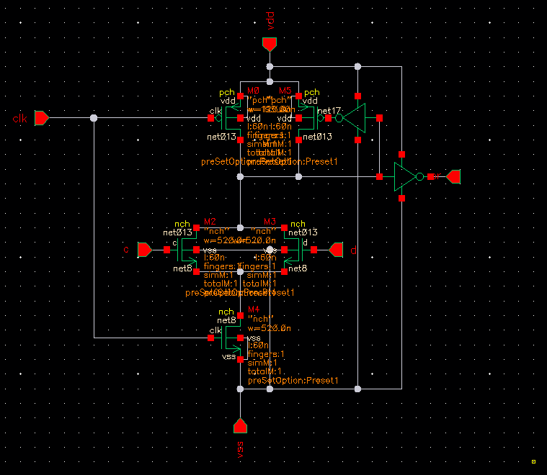
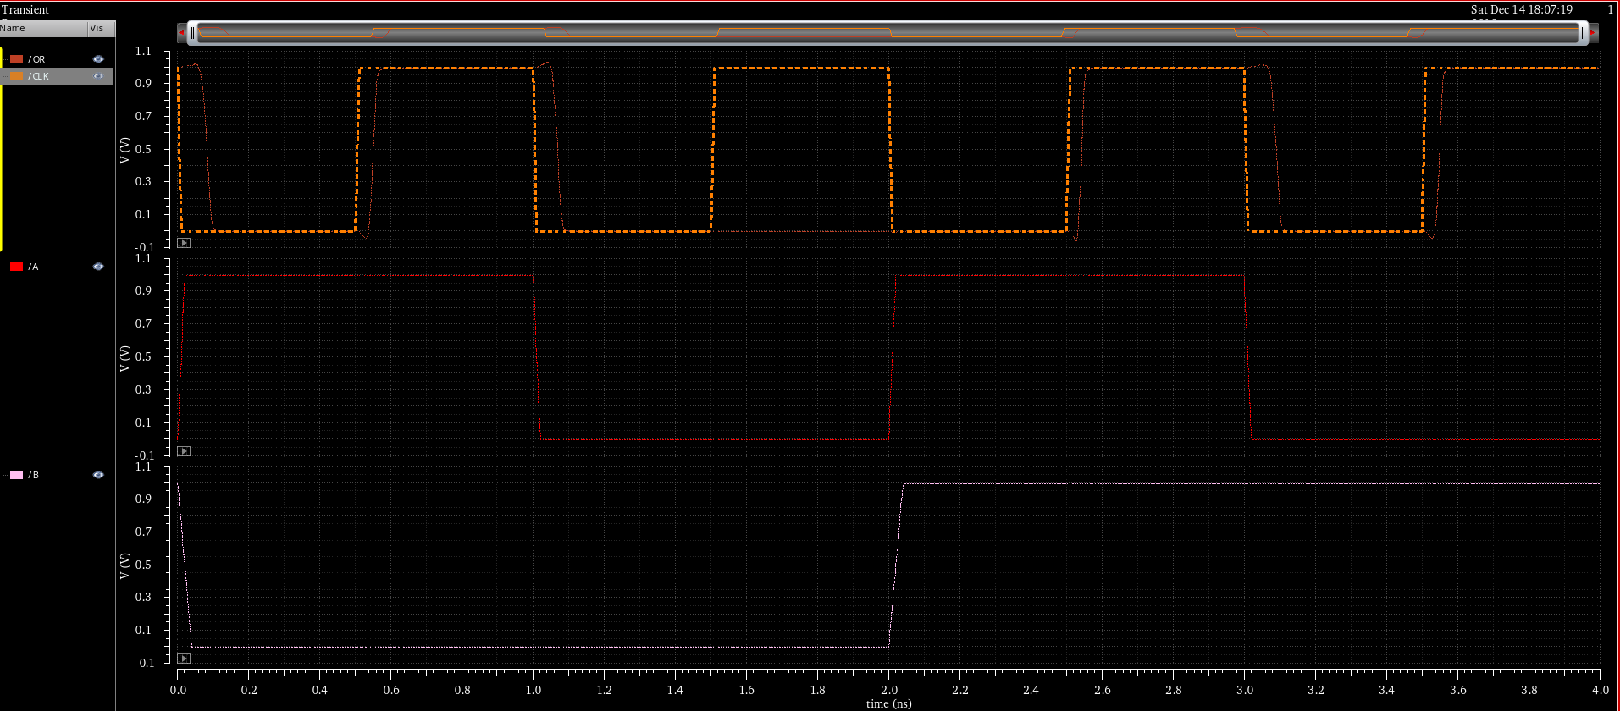
Basic block
Domino OR gate

Slide 4
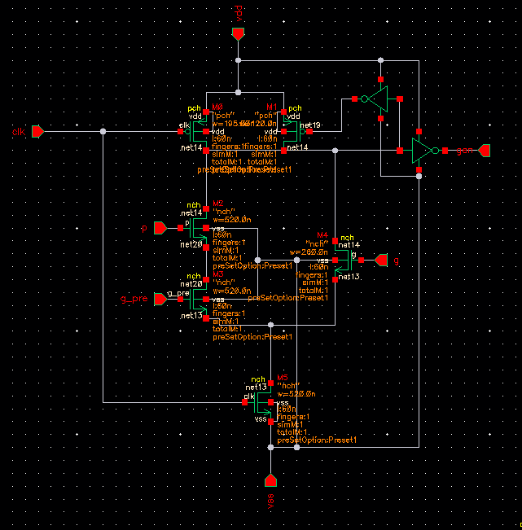

Basic block
Carry generation logic
$$G_{i:k}=G_{i:j}+ P_{i:j}G_{j:k}$$

Slide 5
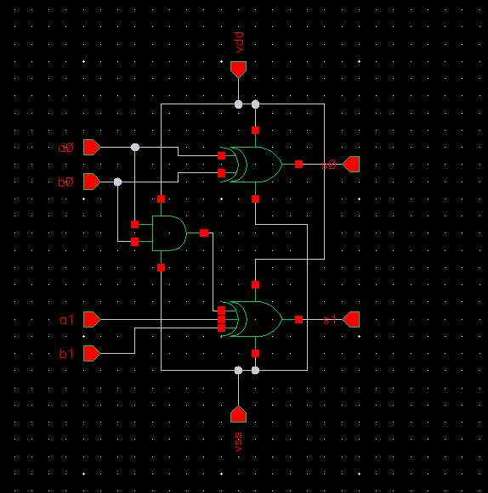
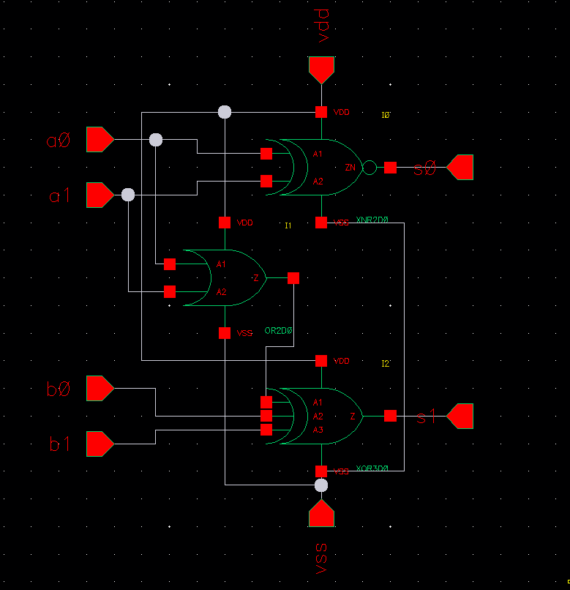
Basic block
Sum pre-compute logic
The carry input is zero
The carry input is one

Slide 6
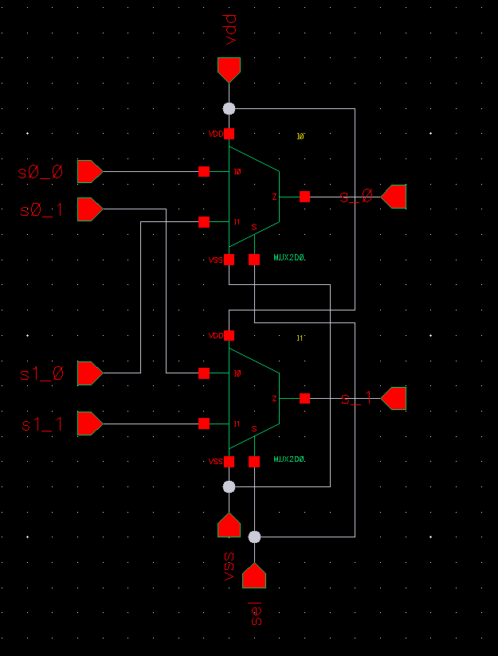
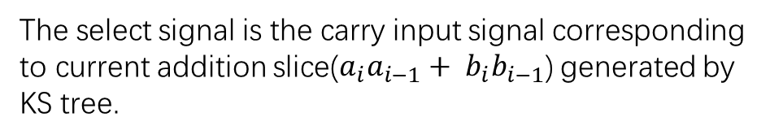
Basic block
Sum select logic
The select signal is the carry input signal corresponding to current addition slice($a_{i}a_{i−1}+ b_{i}b_{i−1}$) generated by KS tree.

Slide 7
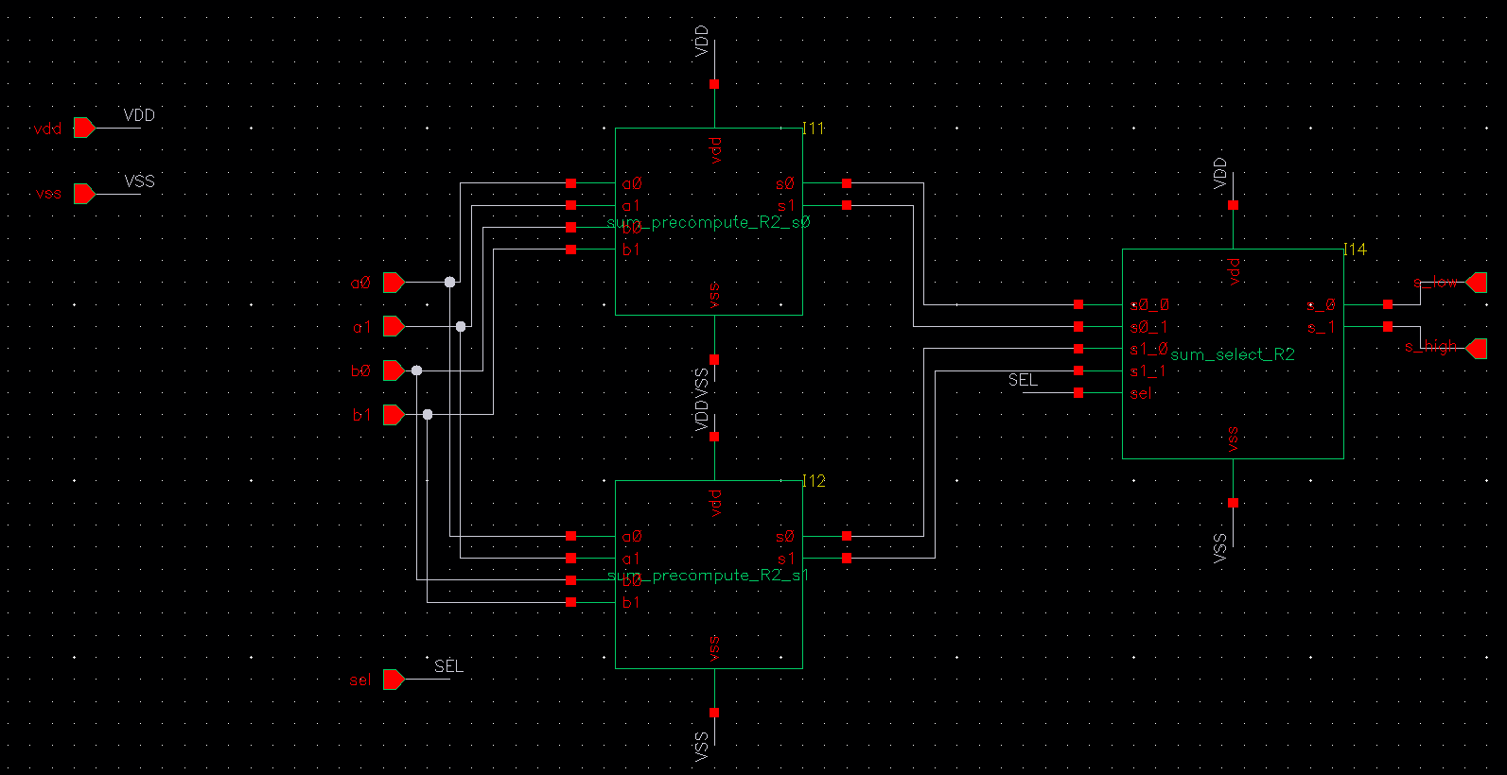
Sum compute logic

Slide 8
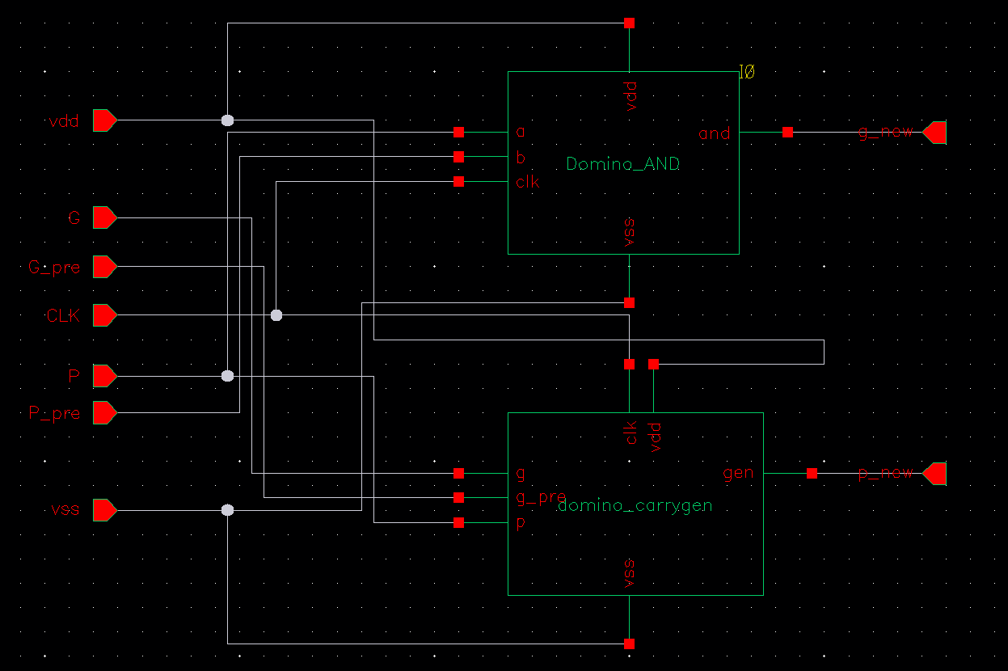
KS tree node
The KS tree node is used to fuse carry generation signal and carry propagation signal from previous stage.
Because the radix of this KS tree is two, so one KS tree node can fuse 2 carry generation signals and 2 carry propagation signals

Slide 9
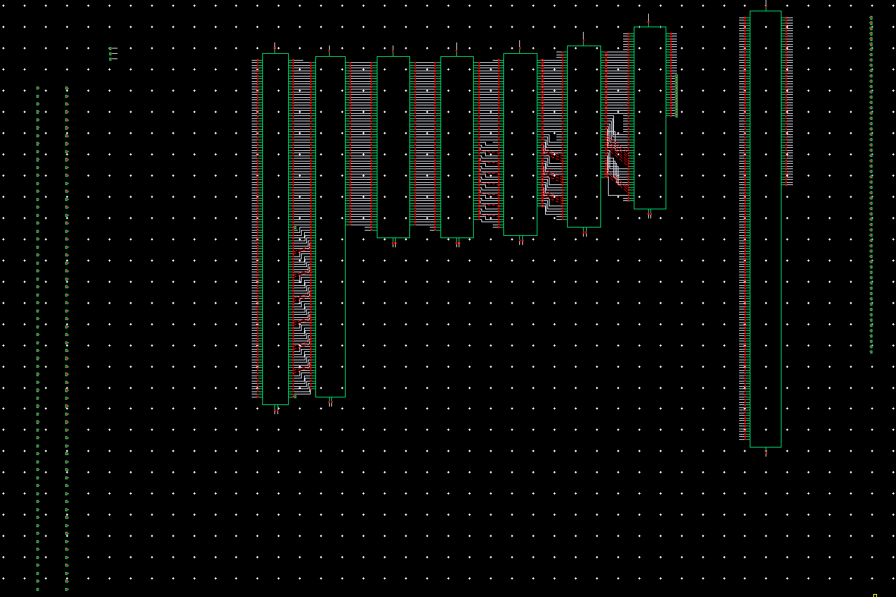
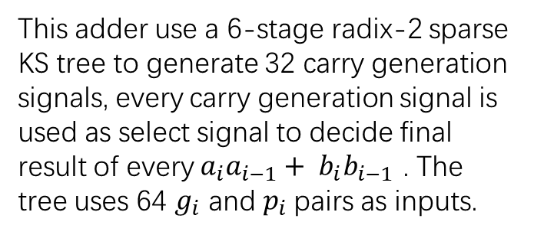
KS tree of radix-2 sparse-2 adder
This adder use a 6-stage radix-2 sparse KS tree to generate 32 carry generation signals, every carry generation signal is used as select signal to decide final result of every $a_{i}a_{i−1}+ b_{i}b_{i−1}$ . The tree uses 64 $g_{i}$ and $p_{i}$pairs as inputs.

Slide 10
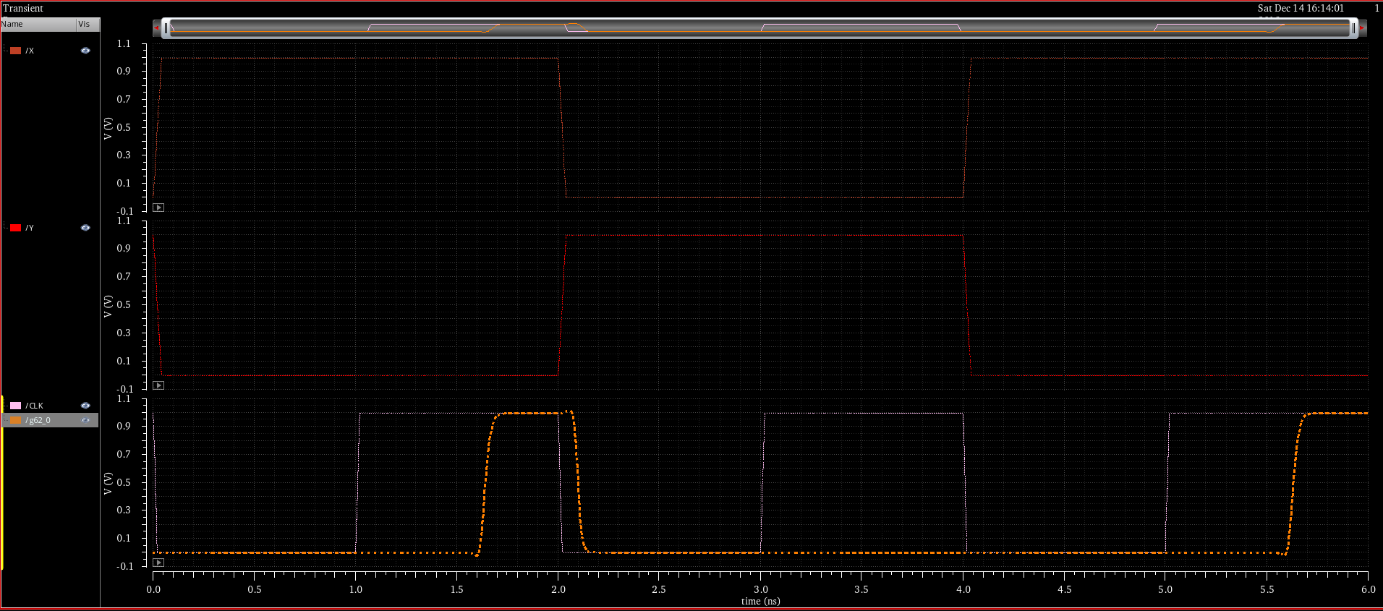
Simulation
Input: 000…001 and 011…111
Clock period: 2 ns

Slide 11
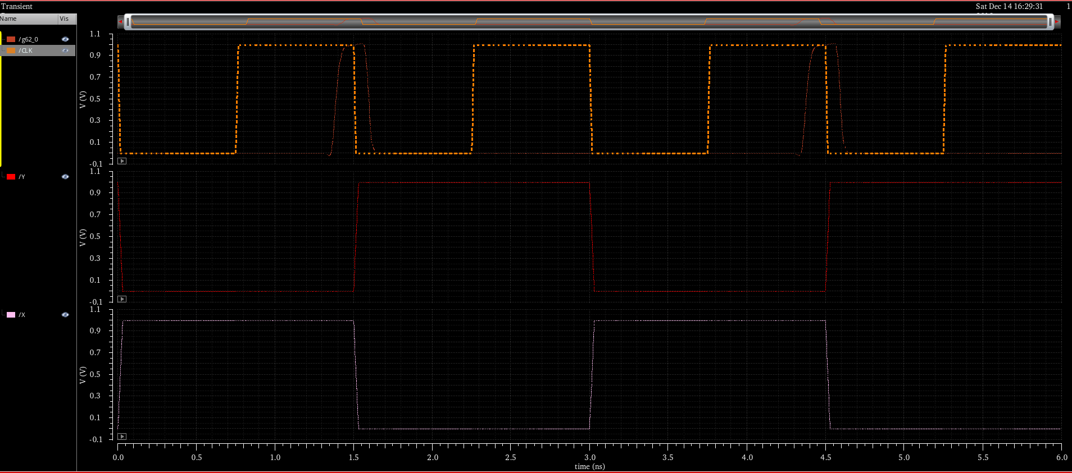
Simulation
Input: 000…001 and 011…111
Clock period: 1.5 ns

Slide 12
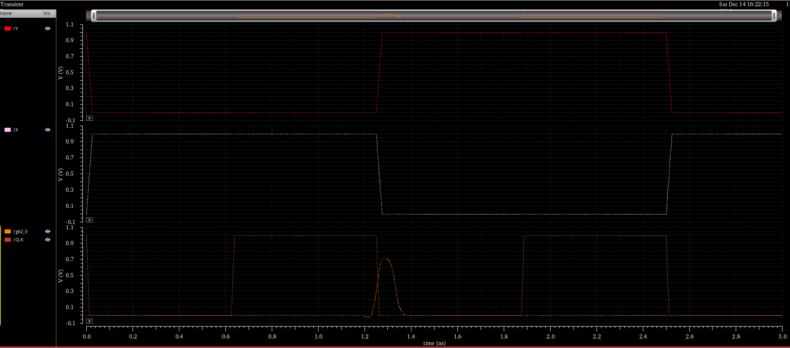
Simulation
Input: 000…001 and 011…111
Clock period: 1.25 ns

